Slide 1

TrendSurge: Unlocking YouTube Insights for Marketing
TrendSurge is a cutting-edge data analytics project designed to revolutionize YouTube marketing strategies. By harnessing the power of data, TrendSurge empowers businesses to make informed decisions and achieve exceptional results on the world's largest video platform.
by khalil abdesslem

Slide 2




What is TrendSurge?
Data-Driven Insights
Marketing Solutions
YouTube Optimization
TrendSurge analyzes data from the top 400 YouTube channels across major markets.
The project aims to provide actionable insights to optimize YouTube marketing campaigns.
TrendSurge helps businesses understand YouTube trends and create successful video strategies.

Slide 3

Why is This Important?
1
Rapidly Evolving Trends
YouTube trends change quickly, making it difficult for marketers to keep up.
2
Content Strategy is Key
Knowing what content resonates with viewers is crucial for success on YouTube.
3
Regional Preferences Matter
Different unique preferences, requiring tailored marketing approaches.
4
Data Overload is Real
vast amounts of data, making it hard to extract meaningful insights.

Slide 4

How Does TrendSurge Work?
1
2
3
Data Collection
Key Metrics Analysis
Data-Driven Insights
TrendSurge gathers data from the top 100 channels in the USA, Canada, Australia, and the UK and trends data in those countries.
The project analyzes engagement rates, video length, upload frequency, and trending topics...
TrendSurge identifies patterns and trends to inform data-backed marketing strategies.

Slide 5
The Challenges We Address
Trend Identification
Content Optimization
Adaptation
TrendSurge helps agencies stay ahead of the curve by identifying emerging trends early on.
Provides data-driven recommendations to rechape strategies
Delivers insights on preferences to help agencies tailor their content for different markets.

Slide 6

Skills Used in the Project
Data Analytics
Marketing Strategy
Collecting, cleaning, and analyzing large datasets to extract meaningful insights from YouTube data.
Translating data insights into actionable marketing strategies to improve campaign performance.
Data Handling
Trend Analysis
Managing and querying large datasets to ensure data integrity and efficiency.
Identifying and interpreting emerging patterns in YouTube data to anticipate future trends.

Slide 7
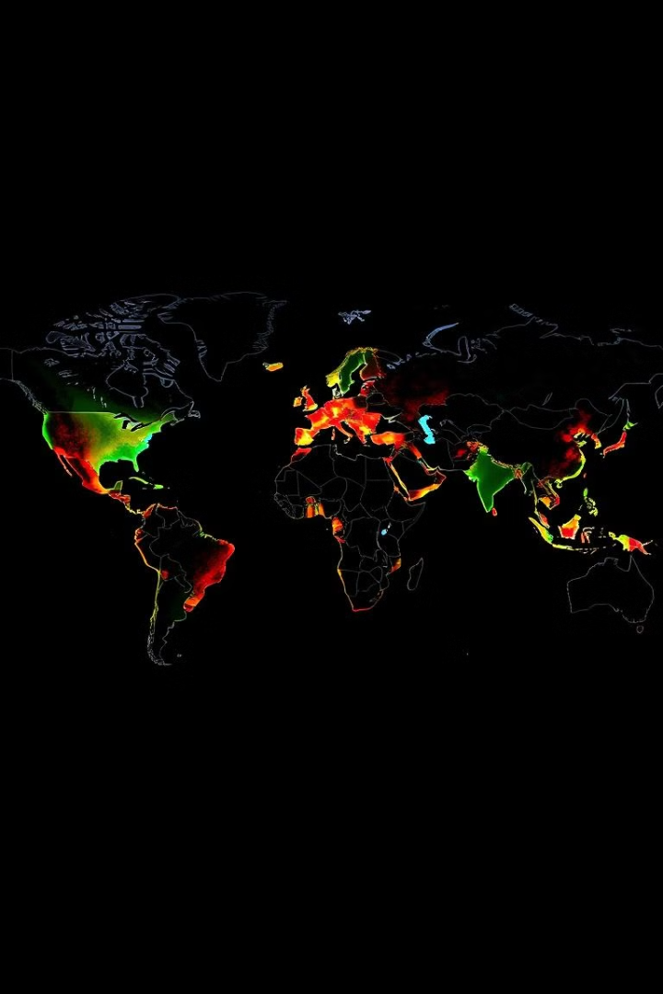
Key Insights To Discover
1
Optimal Video Lengths
Different video categories perform best with specific video lengths, impacting viewer engagement.
2
Upload Frequency Patterns
Higher engagement correlates with certain posting schedules, optimizing content visibility.
3
Regional Trends
Trending topics vary significantly between regions, highlighting the importance of tailored strategies.

Slide 8




Why TrendSurge Matters for Marketing Agencies
Data-Driven Decisions
TrendSurge empowers agencies to move from guesswork to data-backed decision-making.
Enhanced Efficiency
Save time and resources by leveraging data insights to optimize campaigns effectively.
Competitive Edge
Gain a competitive advantage by understanding YouTube trends and adapting strategies accordingly.

Slide 9

Ready to unlock the power of data-driven YouTube marketing? Stay tuned for more insights and solutions from TrendSurge.

Slide 10

Thank You
Thank you for considering TrendSurge. We look forward to helping you achieve YouTube marketing success.

